Slide 1
Kansas Income Tax Changes 2017
Presented by
Hosted by

Slide 2
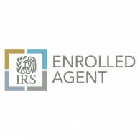
Presenters
Judy Sullivan, MBA/President/Enrolled Agent
Accounting Partners Inc.
Small Business & Construction Industry Specialists
100 W. Nichols St.
Spring Hill, KS 66083
Joey McMullen, Tax Manager/Enrolled Agent
Accounting Partners Inc.
Small Business & Construction Industry Specialists
100 W. Nichols St.
Spring Hill, KS 66083

Slide 3
What is an Enrolled Agent?
An enrolled agent is a person who has earned the privilege of representing taxpayers before the Internal Revenue Service by either passing a three-part comprehensive IRS test covering individual and business tax returns, or through experience as a former IRS employee. Enrolled agent status is the highest credential the IRS awards. Individuals who obtain this elite status must adhere to ethical standards and complete 72 hours of continuing education courses every three years. Enrolled agents, like attorneys and certified public accountants (CPAs), have unlimited practice rights. This means they are unrestricted as to which taxpayers they can represent, what types of tax matters they can handle, and which IRS offices they can represent clients before.

Slide 4
Income Tax Rates And Withholding Rates Changed For Individuals, Estates, And Trusts
The 2017 Legislature increased individual income tax rates retroactively for tax year 2017, and further increased them for tax year 2018 and later years. The changes were made in Senate Bill 30, amending K.S.A. 79-32,110, the statute which establishes the rates of state income tax. The changes are in effect beginning July 1, 2017.

Slide 5
What Changed?
Higher tax rates for all wage earners who file a Kansas Income Tax return starting in 2017.
Non-wage income is now taxable in Kansas starting in 2017.
Increased Itemized deductions starting in 2018.
Changes to the low income exclusion starting in 2018.
Child and Dependent Care credit starting in 2018.

Slide 6
Kansas Income Tax rates for Married or Joint Filing Status Individual Income Tax Returns
Taxable Income | 2016 | 2017 | 2018
Not over $30,000 | 2.7% | 2.9% | 3.1%
Over $30,000, but not over $60,000 | 4.6% | 4.9% | 5.25%
Over $60,000 | 4.6% | 5.2% | 5.7%
K.S.A. 79-32,110

Slide 7
Married or Joint filing status with wage income (W-2) examples of the new Kansas Income tax rates
 | $25,000 | $50,000 | $75,000 | $100,000
2016 | $675 | $1,730 | $2,880 | $4,030
2017 | $725 | $1,910 | $3120 | $4,585
Difference | $60 | $180 | $240 | $555

Slide 8
Kansas Income Tax rates for all other Individual tax returns as well as Estates & Trusts returns
Taxable Income | 2016 | 2017 | 2018
Not over $15,000 | 2.7% | 2.9% | 3.1%
Over $15,000, but not over $30,000 | 4.6% | 4.9% | 5.25%
Over $30,000 | 4.6% | 5.2% | 5.7%
K.S.A. 79-32,110

Slide 9
Individual filer with wage income (W-2) examples of the new Kansas Income tax rates
 | $25,000 | $50,000 | $75,000 | $100,000
2016 | $865 | $2015 | $3165 | $4315
2017 | $925 | $2,210 | $3510 | $4810
Difference | $60 | $195 | $345 | $495

Slide 10
Withholding Tax Changes
Under the provisions of the new legislation this task is complicated by the fact the income tax rates for tax year 2017 are changing in mid-year, meaning many employees will not have had enough tax withheld for the year. In addition, tax rates will change again in only 6 months because different rates become effective January 1, 2018, for tax year 2018.
To address these concerns the Department has updated the withholding tax tables to reflect the higher 2018 tax year withholding tax rates. Applying these rates to the second half of tax year 2017 should allow most employees to “catch-up” on their withholding for tax year 2017.

Slide 11
Examples of non-wage income which is now taxable in Kansas
Nonwage Business Income (self employed wages, sole proprietors)
Income From Certain Entities and Certain Types of Income (partnerships, S corporations, limited liability companies, estates and trusts, income from rental real estate, royalties, residual interests in real estate mortgage investment conduits, and net farm rental)
Farm Income
Draft, Breeding, Dairy Animals, and Animals Used for Sporting Purposes
Stockholders in Banks and Savings and Loans
Christmas Tree sales

Slide 12
Individual filer with non-wage income examples of the new Kansas Income tax rates
 | $25,000 | $50,000 | $75,000 | $100,000
2016 | $0.00 | $0.00 | $0.00 | $0.00
2017 | $925 | $2,210 | $3,510 | $4,810
Difference | $925 | $2,210 | $3,510 | $4,810

Slide 13
Married or Joint filing status with non-wage income examples of the new Kansas income tax rates
 | $25,000 | $50,000 | $75,000 | $100,000
2016 | $0.00 | $0.00 | $0.00 | $0.00
2017 | $725 | $1,910 | $3,120 | $4,585
Difference | $725 | $1,910 | $3,120 | $4,585

Slide 14
No Penalty For Underpayment of Tax Due To Rate Change
Section 4 of the Bill amends K.S.A. 79-32,110 by adding subsection (f) which states:
(f) No taxpayer shall be assessed penalties and interest arising from the underpayment of taxes due to changes to the rates in subsection (a) that became law on July 1, 2017, so long as such underpayment is rectified on or before April 17, 2018.

Slide 15
Estimated Tax Payments
Individuals receiving nonwage income that is now subject to tax because of the amendments made in Section 5 of Senate Bill 30 should begin making estimated tax payments immediately. And, because the effective date of the amendments is retroactive to January 1, 2017, consideration should be given to increasing the amount of the estimated payment(s) in order to “catch-up” with the amount of tax had payments been made for the first two quarters of the tax year. Failure to make these estimated payments could result in having to pay a significant amount of income tax being due in April of 2018 when filing the 2017 income tax return.

Slide 16
Itemized Deductions For Individual Income Tax
The new language provides for a phased-in expansion of the amount of itemized deductions currently allowed. This includes charitable contributions, interest on a residential mortgage, and real and personal property taxes. In addition, the amendments allow medical expenses to be claimed as an itemized deduction, starting in 2018.

Slide 17
Itemized Deduction Increases starting in 2018
 | 2016 | 2017 | 2018 | 2019 | 2020
Medical Deduction | 0% | 0% | 50% | 75% | 100%
Mortgage Interest | 50% | 50% | 50% | 75% | 100%
Taxes on Real Estate & Personal Property | 50% | 50% | 50% | 75% | 100%

Slide 18
Changes To Individual Low Income Exclusion
Beginning in tax year 2018 the low income exclusion is reduced to $5,000 for married individuals filing a joint return, and to $2,500 for all other taxpayers.
For tax year 2017, married individuals filing joint returns with taxable income of $12,500 or less, and all other individuals with taxable income of $5,000 or less, shall have a tax liability of zero;

Slide 19
Credit For Child And Dependent Care
Internal Revenue Code Section 21 (26 U.S. Code § 21) allows a federal credit for expenses for the care of a qualifying individual to enable a taxpayer to work or actively look for work. The Kansas credit is based on the amount of federal credit allowed against the taxpayer’s federal income tax liability. The Kansas credit is limited to the amount of Kansas tax due, after all other credits have been allowed. It is not refundable.
2016 | 2017 | 2018 | 2019 | 2020
0% | 0% | 12.50% | 18.75% | 25%

Slide 20
Corporate Income Tax Rates Not Affected
The changes made by Senate Bill 30 do not affect corporate income tax. Corporate income tax rates have not changed. C-corp’s tax rates remain the same.

Slide 21
Tax Saving Idea’s for Individuals
Increase contributions to pre-tax retirement accounts at work
Push as many large medical items to 2018 instead of 2017
Fully fund HSA (Health Savings Accounts) either at work or after tax money contributions
If you are self-employed set up and contribute to either a Simple or SEP IRA account
Fund IRA’s outside of work. Some people may quality for a tax deduction to a traditional IRA account. Roth IRA’s have no tax deduction at this time.
Greater than 2% shareholders in S-Corps having health insurance paid by the S-corp listed on W-2 form

Slide 22
Learning Quest and 529 plan
Contributions deposited in the Learning Quest Education Savings Program (LQESP) or qualified 529 tuition programs (as defined under IRC Section 529) established by another state, up to $3,000 per student (beneficiary); or $6,000 per student (beneficiary) if your filing status is married filing joint. You may have your direct deposit refund sent directly to your LQESP account. Visit learningquest.com for details about saving money for higher education.

Slide 23
How can Accounting Partners help you?
We offer individual tax planning sessions
We prepare individual and business tax returns
We help and assist with any tax resolution problems
We have 2 IRS Enrolled Agents on Staff
We are Certified Pro-Advisor for QuickBooks, Desktop and Online version
We can help with any payroll needs you may have
We are a Certified Consultant for ComputerEase Software
We fix a variety of accounting, payroll, & tax software problems you may encounter

Slide 24
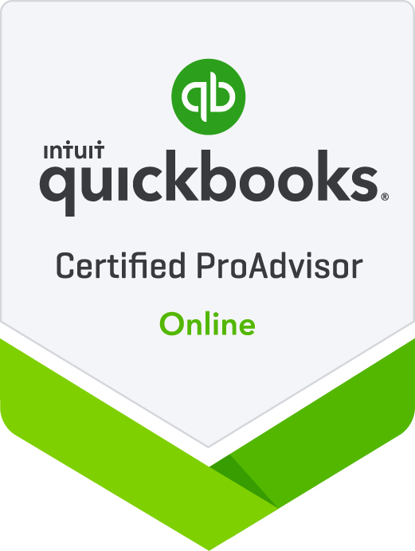
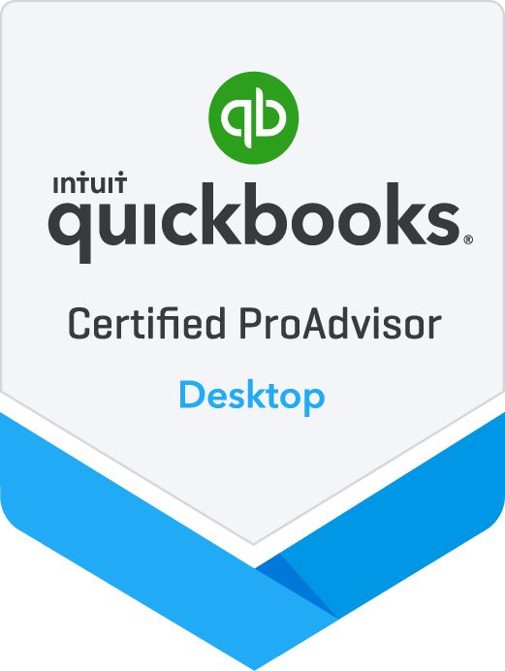
We offer tax personalized tax planning sessions with clients. We also prepare individual and business tax returns.
913-592-3751 taxpro@accountingpartnersinc.com
www.accountingpartnersinc.com
Thank you to our host

